Slide 1
Welcome to the Places Hub
28 February 2024

Slide 2
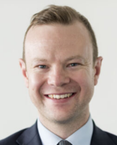
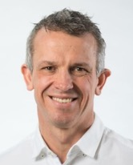
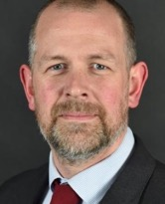
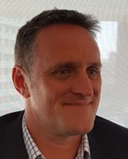
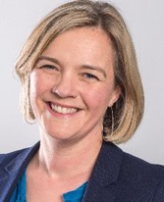
Procuring and implementing public‑private delivery partnerships
1
Adam White
Executive Director, Development Advisory, CBRE
Phil Mayall
Managing Director, Muse Places
Roy Barry
Partner / Head of Development, Brabners LLP
Paul Richards
CEO, Stockport Mayoral Development Corporation
Jessica Bowles
Director of Strategy, Bruntwood
Andrew Ferguson
Partnerships & Property Director, LCR

Slide 3
Procuring and implementing public‑private delivery partnerships

Slide 4
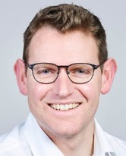
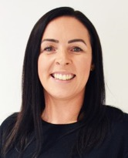
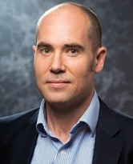
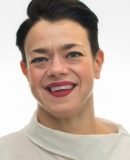
How do we deliver more affordable homes?
2
Alistair Chapman
Senior Director, Development Advisory, CBRE
Jackie Rigby
Assistant Director, Place, Partnerships and Capacity, Homes England
Andrew McIntosh
Head of Place, Greater Manchester Combined Authority (GMCA)
Becca Heron
Strategic Director, Growth & Development, Manchester City Council

Slide 5
2
How do we deliver more affordable homes?

