Slide 1
Welcome to the Places Hub
28 February 2024

Slide 2
Putting data and digital infrastructure at the heart of regeneration strategies
1
Megan Hanney Davies
Associate Director, Digital Transformation, CBRE
Matt Hallett
Director, Supply Chain & Consumer Advisory, CBRE

Slide 3
Data & Digital Infrastructure
At the Heart of Regeneration Strategies
28 February

Slide 4
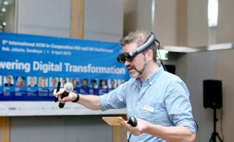
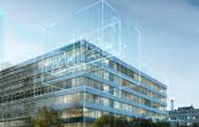
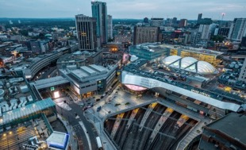
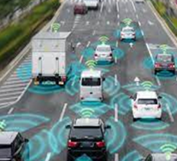
What do we mean by Digital?
data and digital infrastructure
Building Network Connectivity
IoT
Virtual Walkthrough
Space Management
AI / Blockchain
Smart Infrastructure
Mobility as a Service
Data Analytics
Public Safety & Security
Base build requirements
Building Solutions
Digital Workplace
Experience Apps
Integration Platforms
Emerging Technology: Blockchain, Metaverse, AI, IoT
Digital Twin
Air Quality
Smart Infrastructure
Data Analytics
Smart Mobility
Hybrid Experience
Data Security
Data Analytics
Notes:
Using technology and digital as the enabler for outcomes such as:
Creating a hybrid experience – where physical spaces and digital tools meet, connecting people. E.g. interactive wayfinding, community apps connecting residents and businesses
Making data work – gathering insights on metrics such as footfall, preferences and needs. This allows tailoring to the demographic for amenities, events and infrastructure
Example –
Wythenshawe town centre regeneration – digital CGI masterplans have been created for local feedback. Plan is to be a low carbon community
Leeds City Council has worked with the city’s BID to offer a free digital service providing real-time key city intelligence to businesses (footfall, parking etc.) and a communications hub for information sharing.

Slide 5
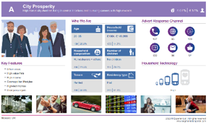
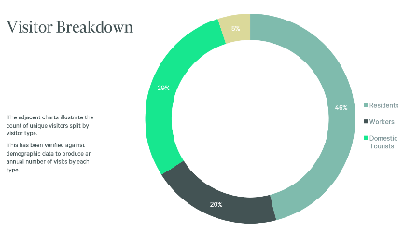
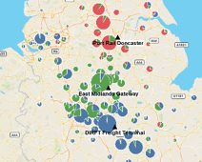
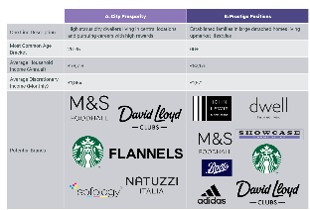
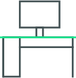
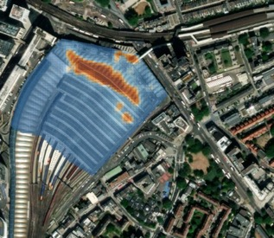
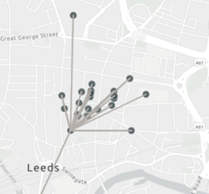
Using data to design places that work for their consumers
data and digital infrastructure
When
Where
Who
Work
Tourism
Competition
Movements
Notes:
Placeholder – Matt Slide
Place for people → Data & digital can help you better understand what people want/ need [Matt’s analytics to help pre-empt/ build assumptions based on past behaviours. How people move through a town can inform type of land use to be built. Location specific, visitor trends. How we use that data
Is there a Manchester development we can reference here?
Mayfield public park safety security – use of AI

Slide 6
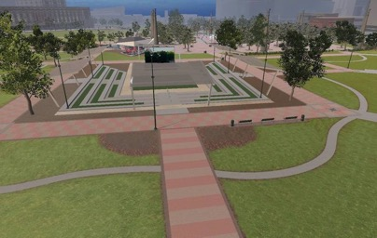
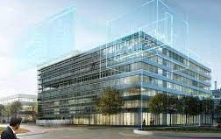
data and digital infrastructure
By harnessing the power of data-led design, communities can move beyond passive participation and become creators of their town centre’s future. This fosters a sense of ownership, builds trust, and ultimately leads to more sustainable and impactful regeneration projects.
Using data-led design to inspire community engagement
Artificial Intelligence
Metaverse
Digital Twin
Analyse proposals against historical applications
Anticipate how design will impact planning approvals
Automate due diligence to help development teams
Better predict risk for pro-active adjustments in planning applications
Host community engagement
Help the community understand the vision for the site
Enable interaction between planners and developers, council and the public
A sustainable option for site visits
Enable smarter operational predictions
Optimise building performance
Insights on sustainability via IoT analytics
Enhance occupier user experience
Notes:
Nimby/ CityIntelek – CBRE PropTech Challenge How it works — nimby.ai | Predictability in Planning
https://www.northstarmeetingsgroup.com/News/Convention-and-Visitor-Bureaus/Atlanta-Metaworld-Meetings-Infrastructure-Metaverse
Hold infrastructure meetings in the metaverse – planners can interact with developers and developers can engage the community by showing them schemes - providing a virtual way to become familiar with the destination. Also offers a more sustainable option for site visits.
Data-driven design allows for informed decision making about town centre regeneration, tailoring solutions to the specific needs and aspirations of the community.
AI/ML –
Key use case is in the planning applications space, can be used to predict success of planning applications using tools such as nimby.ai, which analyse proposals against historical applications to determine how likely proposals are to succeed
Metaverse –
Hold infrastructure meetings in the metaverse – planners can interact with developers and developers can engage the community by showing them schemes - providing a virtual way to become familiar with the destination. Also offers a more sustainable option for site visits.
BIM/Operational Digital Twin –
Digital replicas of physical spaces can be developed which can be used to simulate the effects of different interventions and schemes in order to optimise outcomes. Can also provide in-depth IoT analytics for buildings so they can optimise energy usage as well as improve overall tenant experience

Slide 7
Creating the digital blueprint to futureproof town centres
data and digital infrastructure
High Speed Fixed Broadband
Enhanced Understanding of Resident Needs and Behaviours
Electrical Vehicle Charging
WiFi
Improved Public Services & Infrastructure
A digital blueprint acts as a roadmap for integrating data and digital infrastructure into town centre regeneration. It presents a variety of use cases, all of which are enabled by key infrastructure.
IoT Cloud Platform
Personalised & Engaged Experience
Data Lake
Digital Skills Training
Attracting Investment & Business
Data & Operations Centre
Notes:
Megan: core part of what people want in the scheme.
Knowing the tech and infrastructure which best enables high value use cases.
Help clients to prioritize & roadmap - where we spend most time) to make sure they select right initiatives to realise benefits/potential
Matt: Using data on people to help inform use cases
A digital blueprint acts as a roadmap for integrating data and digital infrastructure into town centre regeneration
Enables a variety of use cases which are underpinned by infrastructure
Enhanced Understanding of Resident Needs and Behaviours
Footfall tracking and analysis, demographic data analysis, social media sentiment analysis. Understanding how people move through town centre, identifying popular and underutilised spaces
Improved Public Services and Infrastructure:
Connected traffic management systems, real-time energy monitoring, smart waste management
Personalised and engaged experience:
Augmented reality experiences, interactive wayfinding, digital loyalty programs
Attracting investment and business:
Online business portals, data-driven property reports (attracting investors with insights on demographics, footfall patterns etc.),
All of these use cases are underpinned by important infrastructure which enables them to have the highest positive impact.
E.g. high speed fixed broadband is crucial to ensure people and businesses are consistently connected. IoT Cloud Platform allows data collection from IoT devices so metrics such as footfall and temperature can be assessed.

Slide 8
Embedding delivery models into new build schemes
data and digital infrastructure
Implementing well-defined delivery models establishes clear roles, responsibilities and accountability throughout the project lifecycle. This clarity fosters streamlined workflows, minimises delays and optimises resource allocation.
Identify Gap & Upskill Workforce
Governance & Change Management
Measures of Success
Leveraging talent and equipping project teams with the necessary digital and data-driven skills is crucial for effective implementation.
Proactive investment in robust governance structures and change management strategies mitigates risks and fosters organisational adaptation.
Having the infrastructure to collect meaningful data allows for successful measuring of things such as: footfall, spend, public transport use, community engagement, usage of green space.​
Notes:
Intro text, explain importance of delivery models
Skills - Upskilling and talent acquisition initiatives ensure teams have the right skillsets and knowledge to make optimal, informed decisions.
Governance & Change management - This investment ultimately contributes to achieving project goals and maximising the return on digital initiatives.

Slide 9
The building blocks to success
1
Using data to design places that work for consumers
2
Using data-led design to inspire community engagement
Refined value proposition with digital & data capabilities
3
Creating the digital blueprint to futureproof town centres
4
Embedding delivery Models into new build schemes
Promotion to occupiers, residents, funding partners & wider society

Slide 10
Thank you
Matt Hallett
Director, Supply Chain & Consumer Advisory
Megan Hanney Davies
Associate Director
Digital Transformation

Slide 11
Unlocking Value from Real Estate
2
Andrew Playfer
Senior Director, Development Advisory, CBRE

Slide 12
How the Public Sector can unlock value from existing real estate portfolios to free up capital and land for infrastructure investment
28 February 2024
Notes:
Public Sector Estates – Unlocking Value to Provide Opportunity

Slide 13
Contents
Infrastructure and Public Sector – the scale of the opportunity
What is the problem?
What is the opportunity?
What is the solution?
Example – Stockport – Town Centre Interchange
Conclusion

Slide 14
Infrastructure context
National infrastructure and construction pipeline – includes projects across sectors such as transport, energy, water, housing, and digital infrastructure
Unlocking Value FROM REAL ESTATE
660 projects
93 projects
£15.5bn
featured for next 10 years
are in the North West
North West projected spend
£770bn
£315bn
£233bn
of estimated investment over the next decade
Energy schemes pipeline
Transport pipeline
Notes:
On digital infrastructure point – should align with what Catherine's stats are?
Might work having the headline number/context from each bullet point in individual boxes? Easier to talk around? E.g. Transport £233bn

Slide 15
Public Sector estate
Unlocking Value FROM REAL ESTATE
156 million
£21bn
sqm
Cost
300,000
c.137,000
Hectares of land
Built assets
630
£10bn
Local Authority acquisitions since 2013
Spent on Local Authority acquisitions since 2013
Notes:
Do bullet points help to summarise the data and allow you to talk around it?

Slide 16
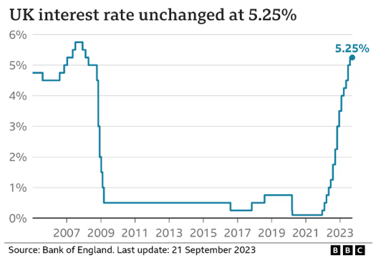
What are the problems?
Unlocking Value from real estate
Debt is currently expensive – PWLB Rates are currently at 5% on a 10-year loan
Residual values are not at a level to support development
Lack of investor appetite
Local Authorities are facing a financial crisis – for example Nottingham Council and Birmingham City Council issuing Section 114 notices
Inflation – rising costs putting further financial pressure on the Public Sector
Notes:
Do you want to include how planning is a challenge?

Slide 17
What is the opportunity?
Public Sector is integral to the solution
Public Sector asset base has potential to unlock capital
Seismic shifts in how our towns and cities are used provide a new opportunity to rethink our approach
Regeneration can facilitate and drive improvements in infrastructure
Government Funding can unlock the door to Private Sector investment
Interest rates are forecast to fall and may allow Local Authorities to borrow more money to fund projects
Source: CBRE Research
Notes:
Michael Gove recent announcement on relaxing rules?

Slide 18
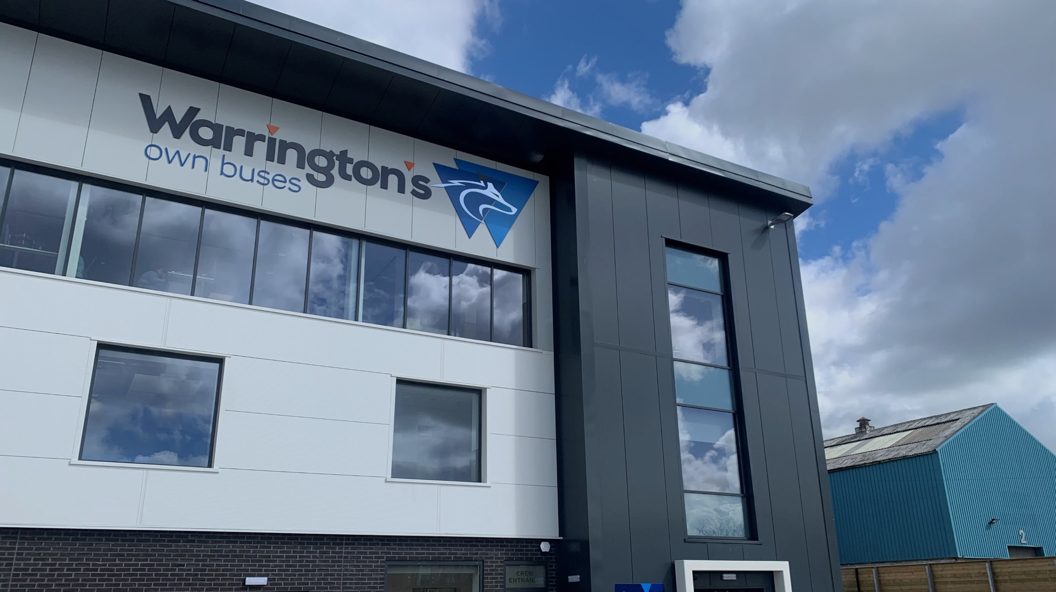
What is the solution?
Infrastructure to be a fundamental part of regeneration projects
Public and Private sector combining investment to achieve optimal improvements
Public sector land utilised either directly as an enabler or indirectly to fund or authorise a project
If interest rates fall this may unlock more capital from both the Private and Public sector
Public sector property estate reviewed and optimised – capital released could in part be used to fund future infrastructure works

Slide 19
Example approach to asset reviews
Unlocking Value from real estate
Stage 1
Cleanse data & merge with other LA data sources.
Stage 2
Identify which assets to evaluate i.e. sector, type, location, use.
Potential outcomes
Asset performing well – to be retained
Asset matches the agreed criteria for a council asset and is retained as part of the optimised portfolio.
Stage 3
Bespoke matrix assessment designed to reflect the type of portfolio being assessed. Criteria reflects council property strategy for optimal portfolio.
Stage 4
Tutorials and workshop with property managers.
Asset management with a view to retention of asset
Asset matches the agreed criteria for a council asset and is retained as part of the optimised portfolio.
Cabinet Paper/AM Programme under Delegated Authority
Asset management with a view to disposal
Poorly performing asset, however with intensive asset management, value could be improved to ensure higher sale value.
Stage 5
Review undertaken by property manager quality assured by CBRE.
Stage 6
Analysis of priority assets undertaken by CBRE.
Divestment
Asset performing poorly i.e. large backlog of maintenance, Poor Net Operating Income, weak covenant, low income, underutilised, management intensive etc. No AM initiatives to drive value.

Slide 20
Outcomes of a review and the implementation of recommendations
Unlocking Value from real estate
An example of reducing cost and improving the quality of a property portfolio
Assets in red identified for disposal, amber for further review and green to retain
TOP PERFORMING ASSETS
COST
INCOME
LOW PERFORMING ASSETS
QUALITY
MANAGEMENT INTENSITY

Slide 21
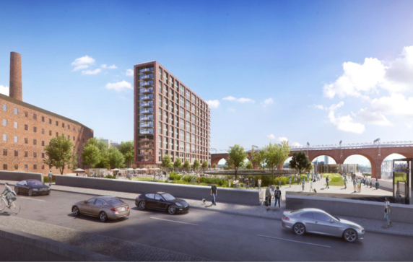
Case Study: Stockport Interchange – Public/Private
The Vision
“200 new apartments above a new transport interchange with provision for car parking spaces and commercial/amenity space beneath the residential development, a raised podium of public space, enhanced connectivity to the town’s rail station and River Mersey frontage, together with a range of additional ancillary infrastructure.”
Unlocking Value from real estate
How?
Joint Venture formed with Developer and Private Funder
Hybrid funding model – Private equity, private debt, public sector grant and patient equity – SPV
TFGM, GMCA, SMBC, Cityheart and Rise Homes
Notes:
Alistair – strategic partnerships
Adam – procurement
Ollie - Blackpool

Slide 22
Summary
Value needs to be unlocked in order to create opportunity
A strategic approach to portfolios will enable capital to be released
Innovative financing will unlock capital tied up in real estate holdings
Public/Private partnerships for investment in infrastructure projects

Slide 23
Closing Remarks
4
Jonathan Moseley
Head of Infrastructure, CBRE

